Slide 1
SC22 Replace Me With Real Template

Slide 2
Software and Hardware: A strained relationship
hard
Hardware gets designed by hardware guys, software gets designed by software guys
Hardware has constraints: feature size, power draw, heat dissipation, complexity
Systems software has constraints, too: hardware and its capabilities
But we use hardware to actually do computing work. So as workloads and software changes, hardware has to and does change.
But only slowly: VMWare released in 1999, vt-d/amd-v come in 05/06.
~6 year lagtime!
Intel VT-D
1999
2000
2001
2002
2003
2004
2005
2006
2007
2008
2009
2010
VMWare released
AMD-V

Slide 3
Why is it like this? What can we do?
Chips are very hard to make. Circuit design, simulations, tapeouts, fabrication delays, costs, etc.
Companies are reluctant to “just try stuff”
Hardware features may not get used anyway: hardware task-switching, x86’s rings 1 and 2, etc.
The components of co-design:
  Reduce time/cost to prototype hardware: FPGAs
  Reduce difficulty to extend ISAs: RISC-V
  Reduce difficulty to test new hardware: extensible, simple software

Slide 4
Extensible, simple software: this work
The grand vision is to do co-design, mainly in HPC and confidential/secure computing
We need a suitable kernel to test this (possibly very experimental) hardware
  This work is a stepping stone toward that vision
So, to start, we port Kitten

Slide 5
Co-Design is as hard as you make it: complexity
The “semantic gap” is a design barrier between hardware and software that allows increased complexity
But, at the cost of decreased complexity
  Hardware assumes software wants some features, like MMUs, cache coherence, etc.
  Software assumes hardware provides some features, and designs mechanism that exploit those features: paging, processes, multi-processing
The difficulty only arises when both sides are complex:
Design decisions
Design decisions
Design decisions
?
HW
SW
HW
SW
HW
SW

Slide 6
What kind of hardware complexity do we want?
An open-source ISA is critical to co-design.
  Try asking Intel, AMD, etc. to try an experimental change
  Xtensa controllers are an option, but not targeted at research/academia
RISC-V has a good supply of research hardware implementations, exploring a wide variety of architectural ideas (just a few examples):
  Pipelining: SHAKTI
  Superscalar: Berkeley’s RISC-V BOOM
  VLIW: Packet Manipulator
  Manycores: Hammerblade, Manticore

Slide 7
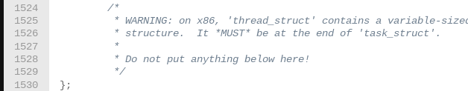
What kind of software complexity do we want?
The obvious choice? Linux!
  However, Linux’s enormous complexity makes modification hard, to say the least.
  The task struct on Linux is ~800 lines long:

Slide 8
What kind of software complexity do we want?
Kitten is a simple, capable kernel that uses fewer hardware abstractions than Linux and uses simpler ones whenever possible.
Kitten is optimized for performance in HPC contexts and can provide Linux ABI compatibility.
  Larger memory page sizes by default
  Contiguous, linear memory mapping
  Simple, round-robin task scheduling
And we already ported it to ARM64

Slide 9
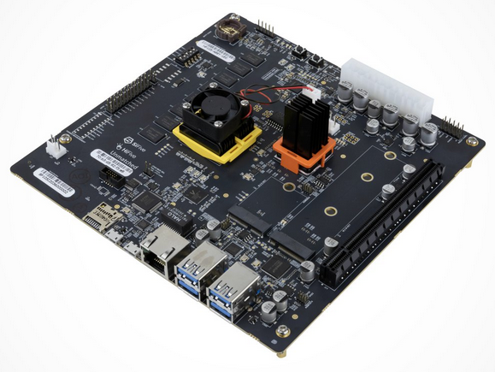
Objectives of the Port
✅ Platforms: QEMU, SiFive Unmatched
✅ Benchmarks: HPCG, STREAM, RandomAccess
OS Features:
  ✅ Single-process support
  ✅ FPU
  ✅ Timers
  × Interrupts
  × Multi-process
  × Multi-core
But these are on the way!

Slide 10
Some interesting lessons learned
Some interesting challenges faced along the way:
  Paging structure
  Linker relaxations
  Register quantity vs ARM and thread-local storage
  L2 cache or scratchpad memory
  L2 cache prefetchers and performance

Slide 11
Paging Structure
Borrow heavily from Linux when possible, can’t borrow here.
Write from scratch.
RISC-V paging structure is very simple. Pick a bit-width (39-bits here) and here’s your format. From the Unmatched manual:

Slide 12
Paging, continued
Leafs are found by checking the RWX permission bits
Accessed/Dirty are controlled by the kernel, not the hardware
  Though an exception will be generated if they are wrong!
A toggle to cause a fault on OS read/write to user pages.
  An interesting opportunity for kernel-managed, secure pages?
Less C structs to manage, simpler memory code

Slide 13
Linker relaxations
RISC-V is a register-rich, but addressing mode-poor ISA.
Addressing any 32-bit address requires two instructions:
  lui/auipc to set hi-20 bits
  ld to specify lo-12 bits
But RISC-V provides a global pointer (gp), which typically points to a part of the BSS section, the small BSS (.sbss).
  Kitten has to load this to the right place
  Have to juggle it when switching from physical to virtual memory, too
The global pointer allows us to elide the auipc/lui instruction
There are other registers, too, that could be extra gps.
  Would allow for more relaxation and thus faster access
  Require toolchain support, like GCC on ARM64 preserving an extra register for system use

Slide 14
Register Quantity and Thread-Local Storage
RISC-V has a good supply of general-purpose registers, but comparatively few system registers.
  When switching tasks, need to store kernel stack, task struct pointer, etc.
  ARM64 has “banked registers” containing context at each level: stack pointer, thread pointer
RISC-V has one architectural “scratch” register per level
  So what do we do? We emulate Linux: put the thread info struct at offset 0 inside the task struct, and point tp to both of them
  Fetch the kernel stack from there

Slide 15
SiFive Unmatched and L2 Cache
The SiFive Unmatched has a very flexible L2 cache that can serve as L2 cache, scratchpad, direct memory, or some mix of all three.
At boot time, must enable cache ways.
Enabled ways can be written to as a scratchpad (where evictions might occur at any time)
Disabled ways can be directly addressed and used as ordinary RAM
  Interesting opportunities for accelerated locks, message-passing buffers, etc.

Slide 16
Performance and cache prefetchers
To assess port completeness and correctness as well as characterize hardware, we ran typical benchmarks on QEMU and the Unmatched
The Unmatched lacks an L2 prefetcher.
  This has some consequences for memory performance.

Slide 17
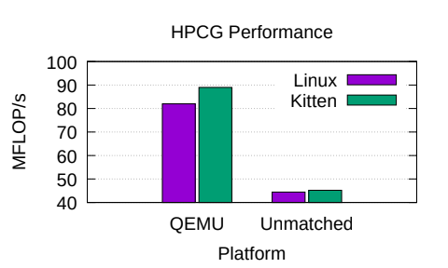
Performance: HPCG
HPCG: A typical benchmark, a decent mix of memory and compute intensiveness.
Kitten on QEMU on the workstation outperforms the Unmatched by a factor of about 2.

Slide 18
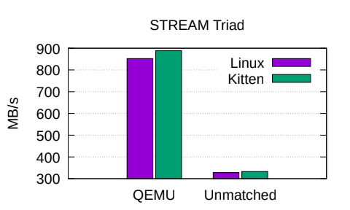
Memory Performance: STREAM and RandomAccess
Two common benchmarks to characterize memory performance
QEMU shows a substantial advantage in STREAM, but not in RandomAccess.

Slide 19
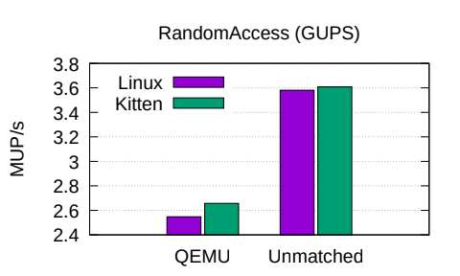
RandomAccess

Slide 20
Thank you!
Feel free to ask any questions you have.

